Slide 1


MATH 242
Analytic Geometry and Calculus B
Section 12
Instructor: Jacob Wyngaard
Trig Integration

Slide 2
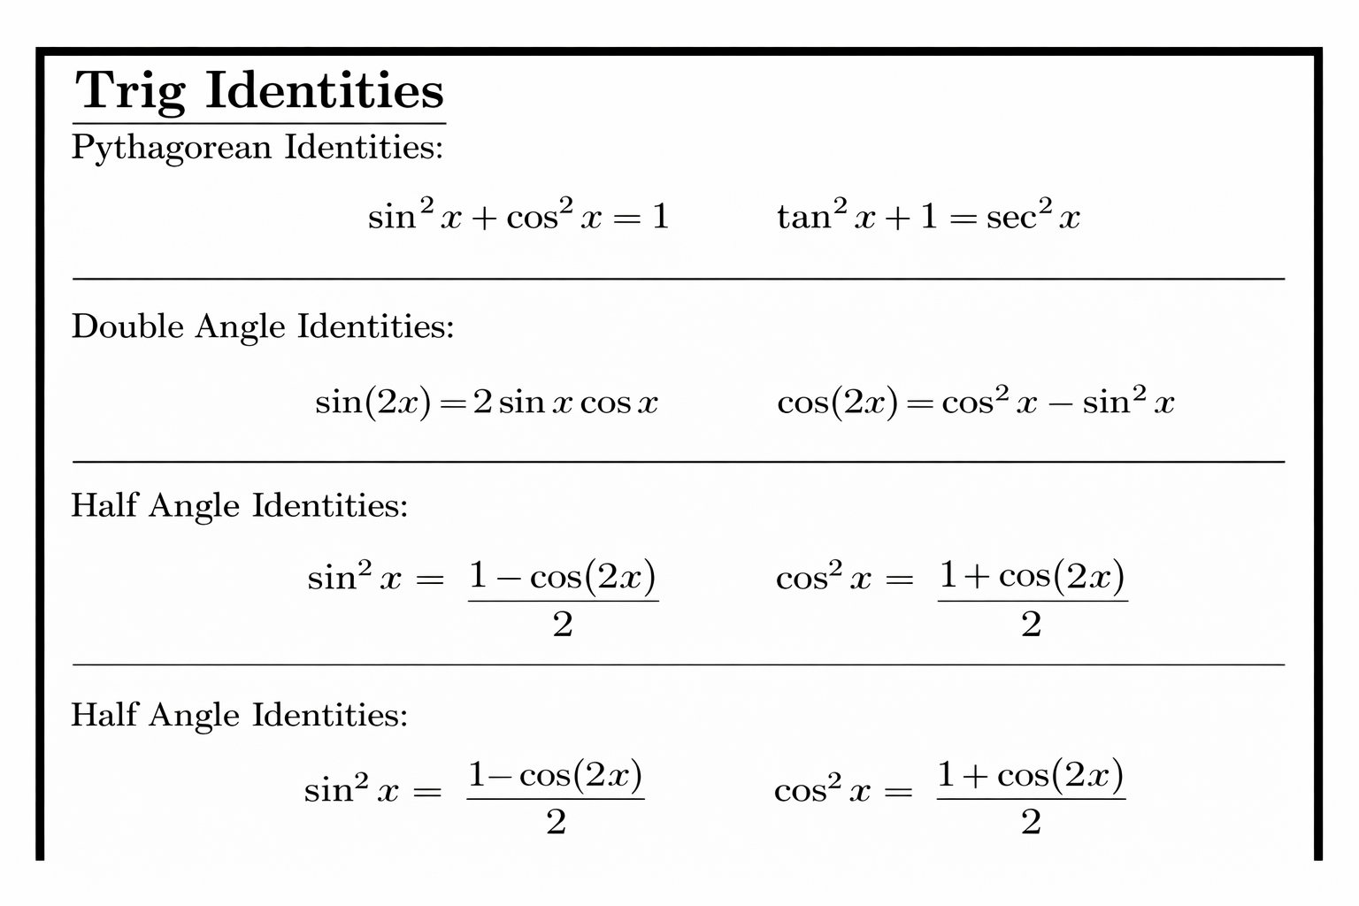
Background
  In Pre-Calculus, we learned some important trig identities
  In this lecture, we will learn how to apply them to tricky integration problems

Slide 3

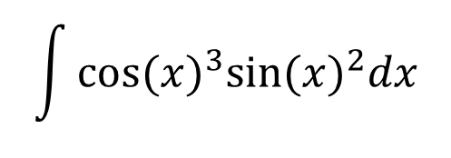
Powers of Sines and Cosines
  Consider the following integral: $\int{{cos⁡(x)}^{n}{sin⁡(x)}^{m}dx}$
  There are three possible strategies
  1. If $n$ is odd, we save one cosine factor and use $\cos^{2}(x) = 1−sin²(x)$ to replace the remaining cosine terms with sine terms
$$\int{{cos⁡(x)}^{3}{sin⁡(x)}^{2}dx}$$
  Example:
  $$\int{{cos⁡(x)}^{3}{sin⁡(x)}^{2}dx}=\int{\cos\left(x\right){cos⁡(x)}^{2} {sin⁡(x)}^{2}dx}$$
  $$⇒\int{{cos⁡(x)}^{3}{sin⁡(x)}^{2}dx}=\int{\cos\left(x\right)(1−{sin⁡(x)}^{2}) {sin⁡(x)}^{2}dx}$$

Slide 4

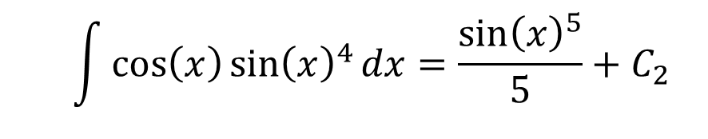
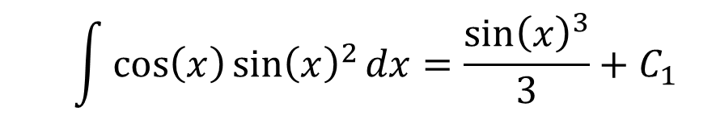
Powers of Sines and Cosines
$$\int{{cos⁡(x)}^{3}{sin⁡(x)}^{2}dx}$$
  Example [Continued]:
  $$\int{{cos⁡(x)}^{3}{sin⁡(x)}^{2}dx}=\int{\left(\cos\left(x\right){\sin\left(x\right)}^{2}−\cos\left(x\right){\sin\left(x\right)}^{4}\right)dx}$$
  Using U-Substitution:
  $$\int{\cos\left(x\right){\sin\left(x\right)}^{2}dx}=\frac{{\sin\left(x\right)}^{3}}{3}+C_{1}$$
  $$\int{\cos\left(x\right){\sin\left(x\right)}^{4}dx}=\frac{{\sin\left(x\right)}^{5}}{5}+C_{2}$$
  and
  $$⇒\int{{cos⁡(x)}^{3}{sin⁡(x)}^{2}dx}=\frac{{\sin\left(x\right)}^{3}}{3}−\frac{{\sin\left(x\right)}^{5}}{5}+C$$

Slide 5
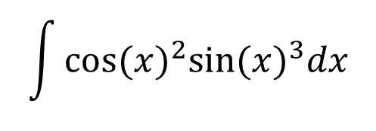
Powers of Sines and Cosines
  Consider the following integral: $\int{{cos⁡(x)}^{n}{sin⁡(x)}^{m}dx}$
  There are three possible strategies
  2. If $m$ is odd, we save one sine factor and use $\sin^{2}(x) = 1−cos⁡(x)$ to replace the remaining cosine terms with sine terms
$$\int{{cos⁡(x)}^{2}{sin⁡(x)}^{3}dx}$$
  Example:
  $$\int{{cos⁡(x)}^{2}{sin⁡(x)}^{3}dx}=\int{{cos⁡(x)}^{2}{sin⁡(x)}^{2}\sin\left(x\right)dx}$$
  $$⇒\int{{cos⁡(x)}^{3}{sin⁡(x)}^{2}dx}=\int{{\cos\left(x\right)}^{2}\left(1−{\cos\left(x\right)}^{2}\right)\sin\left(x\right)dx}$$

Slide 6

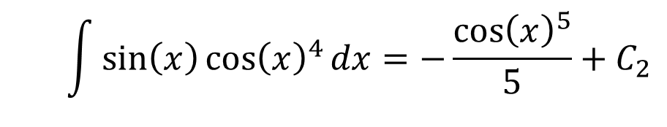
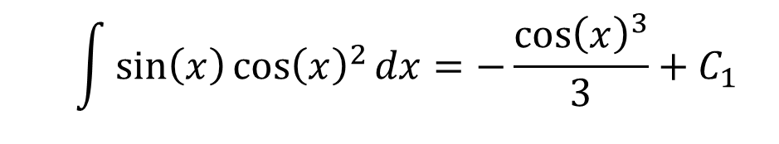
Powers of Sines and Cosines
$$\int{{cos⁡(x)}^{2}{sin⁡(x)}^{3}dx}$$
  Example [Continued]:
  $$\int{{cos⁡(x)}^{2}{sin⁡(x)}^{3}dx}=\int{\left(\sin\left(x\right){\cos\left(x\right)}^{2}−\sin\left(x\right){\cos\left(x\right)}^{4}\right)dx}$$
  Using U-Substitution:
  $$\int{\sin\left(x\right){\cos\left(x\right)}^{2}dx}=−\frac{{\cos\left(x\right)}^{3}}{3}+C_{1}$$
  $$\int{\sin\left(x\right){\cos\left(x\right)}^{4}dx}=−\frac{{\cos\left(x\right)}^{5}}{5}+C_{2}$$
  and
  $$⇒\int{{cos⁡(x)}^{2}{sin⁡(x)}^{3}dx}=\frac{{\cos\left(x\right)}^{5}}{5}−\frac{{\cos\left(x\right)}^{3}}{3}+C$$

Slide 7
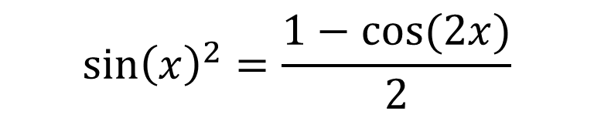
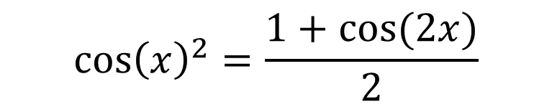

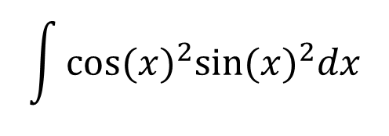
Powers of Sines and Cosines
  Consider the following integral: $\int{{cos⁡(x)}^{n}{sin⁡(x)}^{m}dx}$
  There are three possible strategies
  3. If $n$ and $m$ are even, we need to use the half-angle identity
$${\cos\left(x\right)}^{2}=\frac{1+cos⁡(2x)}{2}$$
$${\sin\left(x\right)}^{2}=\frac{1−cos⁡(2x)}{2}$$
$$\int{{cos⁡(x)}^{2}{sin⁡(x)}^{2}dx}$$
  Example:
$$\int{{cos⁡(x)}^{2}{sin⁡(x)}^{2}dx}=\int{\frac{1+cos⁡(2x)}{2}∗\frac{1−cos⁡(2x)}{2}dx}$$

Slide 8
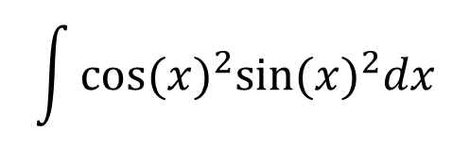
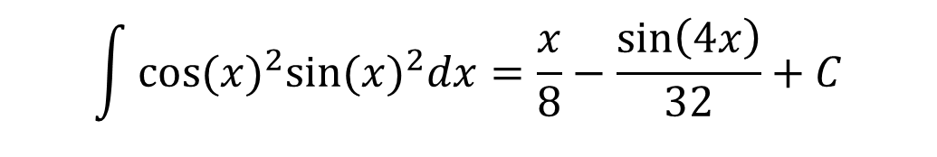
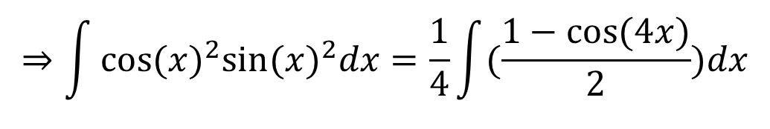
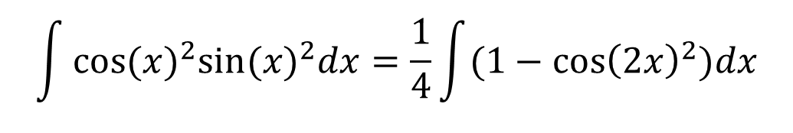
Powers of Sines and Cosines
$$\int{{cos⁡(x)}^{2}{sin⁡(x)}^{2}dx}$$
  Example [Continued]:
$$\int{{cos⁡(x)}^{2}{sin⁡(x)}^{2}dx}=\frac{1}{4}\int{(1−{\cos\left(2x\right)}^{2})dx}$$
By the Half-Angle Formula: ${\cos\left(2x\right)}^{2}=\frac{1+cos⁡(4x)}{2}$
$$⇒\int{{cos⁡(x)}^{2}{sin⁡(x)}^{2}dx}=\frac{1}{4}\int{(\frac{1−cos⁡(4x)}{2})dx}$$
$$\int{{cos⁡(x)}^{2}{sin⁡(x)}^{2}dx}=\frac{x}{8}−\frac{\sin\left(4x\right)}{32}+C$$

Slide 9


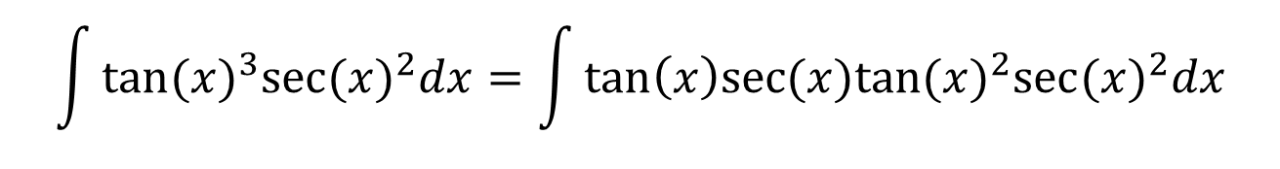
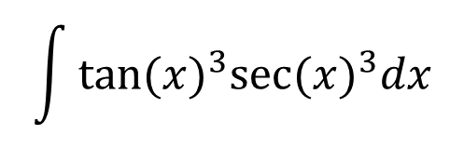
Powers of Tangents and Secants
  Consider the following integral: $\int{{tan⁡(x)}^{n}{sec⁡(x)}^{m}dx}$
  There are two possible strategies
  1. If $n$ is odd, we save factor of $\tan\left(x\right)sec⁡(x)$ and use $\tan^{2}\left(x\right)= \sec^{2}\left(x\right)−1$ to replace the remaining $\tan^{2}\left(x\right)$ terms
$$\int{{tan⁡(x)}^{3}{sec⁡(x)}^{3}dx}$$
  Example:
$$\int{{tan⁡(x)}^{3}{sec⁡(x)}^{2}dx}=\int{{tan\left(x\right)sec(x)tan⁡(x)}^{2}{sec⁡(x)}^{2}dx}$$
$$\int{{tan⁡(x)}^{3}{sec⁡(x)}^{2}dx}=\int{tan\left(x\right)sec(x)({\sec\left(x\right)}^{2}−1){sec⁡(x)}^{2}dx}$$

Slide 10
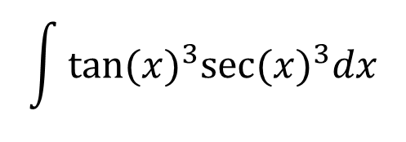
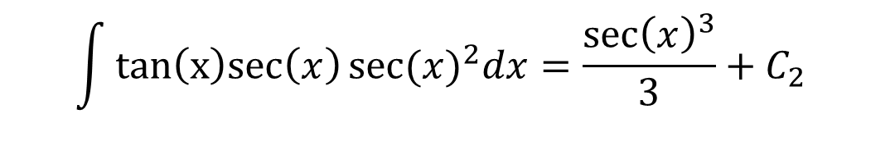
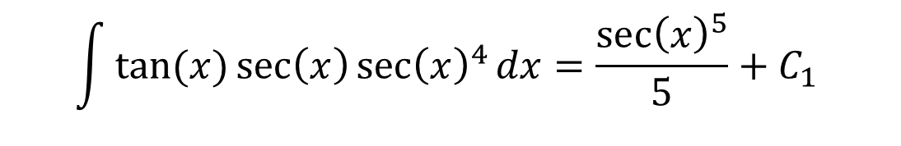
Powers of Tangents and Secants
$$\int{{tan⁡(x)}^{3}{sec⁡(x)}^{3}dx}$$
  Example [Continued]:
  $$\int{{tan⁡(x)}^{3}{sec⁡(x)}^{3}dx}=\int{\left(tan⁡(x)\sec\left(x\right){\sec\left(x\right)}^{4}−tan\left(x\right)sec\left(x\right){sec⁡(x)}^{2}\right)dx}$$
  Using U-Substitution and $\frac{d}{dx}\left[\sec\left(x\right)\right]=\tan\left(x\right)sec⁡(x)$
  $$\int{tan⁡(x)\sec\left(x\right){\sec\left(x\right)}^{4}dx}=\frac{{\sec\left(x\right)}^{5}}{5}+C_{1}$$
  $$\int{tan\left(x\right)sec\left(x\right){sec⁡(x)}^{2}dx}=\frac{{\sec\left(x\right)}^{3}}{3}+C_{2}$$
  and
  $$⇒\int{{tan⁡(x)}^{3}{sec⁡(x)}^{3}dx}=\frac{{\sec\left(x\right)}^{5}}{5}−\frac{{\sec\left(x\right)}^{3}}{3}+C$$

Slide 11

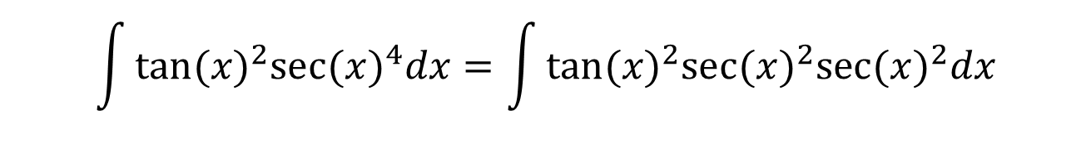
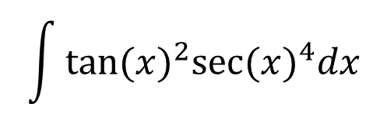
Powers of Tangents and Secants
  Consider the following integral: $\int{{tan⁡(x)}^{n}{sec⁡(x)}^{m}dx}$
  There are two possible strategies
  2. If $m$ is even, we save factor of $\sec^{2}\left(x\right)$ and use $\sec^{2}\left(x\right)=1+\tan^{2}\left(x\right)$ to replace the remaining $\sec^{2}\left(x\right)$ terms
$$\int{{tan⁡(x)}^{2}{sec⁡(x)}^{4}dx}$$
  Example:
$$\int{{tan⁡(x)}^{2}{sec⁡(x)}^{4}dx}=\int{{tan⁡(x)}^{2}{sec⁡(x)}^{2}{sec⁡(x)}^{2}dx}$$
$$\int{{tan⁡(x)}^{3}{sec⁡(x)}^{2}dx}=\int{{\tan\left(x\right)}^{2}\left(1+{\tan\left(x\right)}^{2}\right){sec⁡(x)}^{2}dx}$$

Slide 12
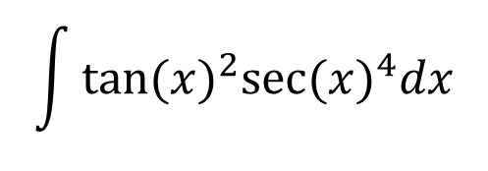
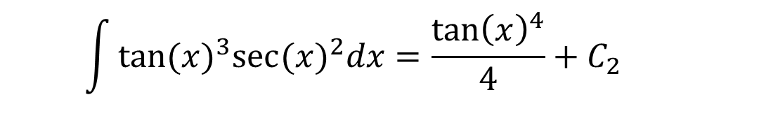
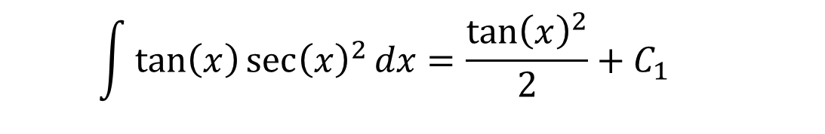
Powers of Tangents and Secants
$$\int{{tan⁡(x)}^{2}{sec⁡(x)}^{4}dx}$$
  Example [Continued]:
  $$\int{{tan⁡(x)}^{2}{sec⁡(x)}^{4}dx}=\int{\left(\tan\left(x\right){\sec\left(x\right)}^{2}+{tan⁡(x)}^{3}{sec⁡(x)}^{2}\right)dx}$$
  Using U-Substitution and $\frac{d}{dx}\left[\tan\left(x\right)\right]={\sec\left(x\right)}^{2}$
  $$\int{\tan\left(x\right){\sec\left(x\right)}^{2}dx}=\frac{{\tan\left(x\right)}^{2}}{2}+C_{1}$$
  $$\int{{tan⁡(x)}^{3}{sec⁡(x)}^{2}dx}=\frac{{\tan\left(x\right)}^{4}}{4}+C_{2}$$
  and
  $$⇒\int{{tan⁡(x)}^{2}{sec⁡(x)}^{4}dx}=\frac{{\tan\left(x\right)}^{2}}{2}+\frac{{\tan\left(x\right)}^{4}}{4}+C$$

Slide 13
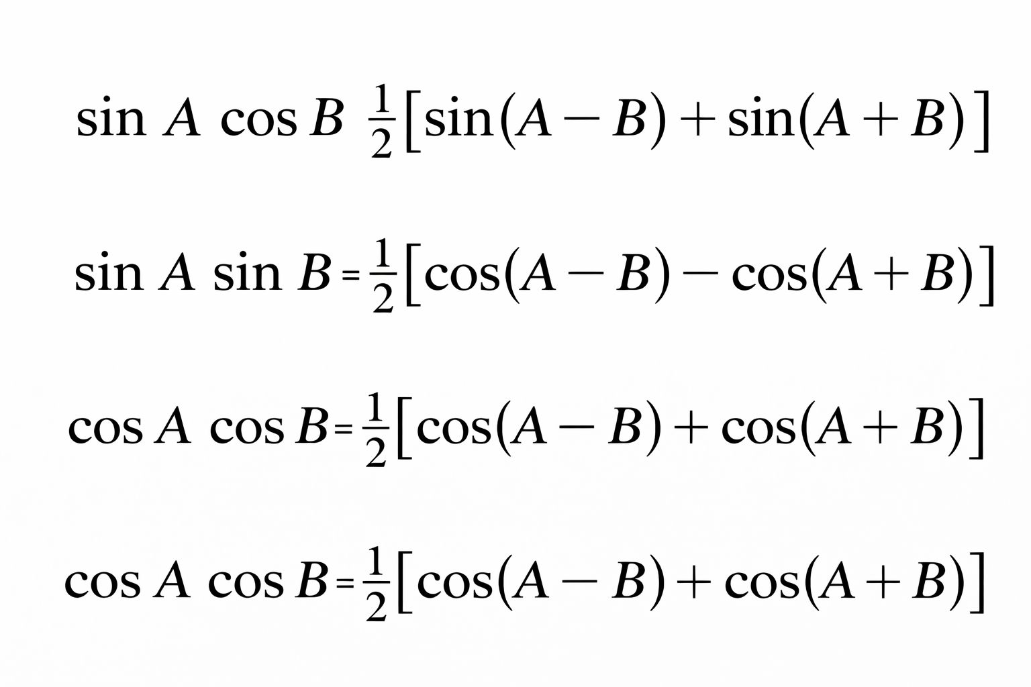



Products of Sines/Cosines
  Consider the following integrals:
$$\int{\sin\left(mx\right)cos⁡(nx)dx},\int{\sin\left(mx\right)sin⁡(nx)dx},\int{\cos\left(mx\right)cos⁡(nx)dx}, m ≠n$$
  To solve these, we need the following trigonometric identities:
$$=$$
$$=$$
$$=$$

Slide 14
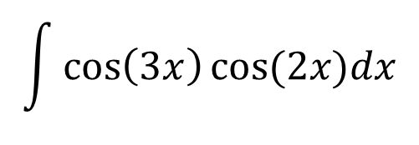
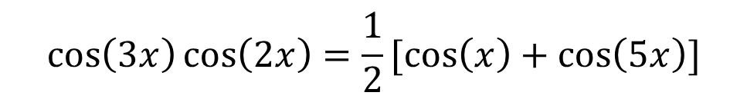
Products of Sines/Cosines
$$\int{\cos\left(3x\right)cos⁡(2x)dx}$$
  Example:
$$\cos\left(3x\right)\cos\left(2x\right)=\frac{1}{2}[\cos\left(x\right)+\cos\left(5x\right)]$$
  By the provided trigonometric identities:
$$\int{\cos\left(3x\right)\cos\left(2x\right)dx=\int{\frac{1}{2}\left[\cos\left(x\right)+\cos\left(5x\right)\right]dx=\frac{sin⁡(x)}{2}+\frac{sin⁡(5x)}{10}+C}}$$

